Slide 1


Hii, Iam Siddhika
Welcome to Power BI Series
Part -13

Slide 2

Today Content
Are you ready guys?
continuing with
CREATING A DATA MODEL
CONNECTING MULTIPLE FACT TABLES FILTER CONTEXT & FLOW
EXAMPLE: FILTER FLOW

Slide 3
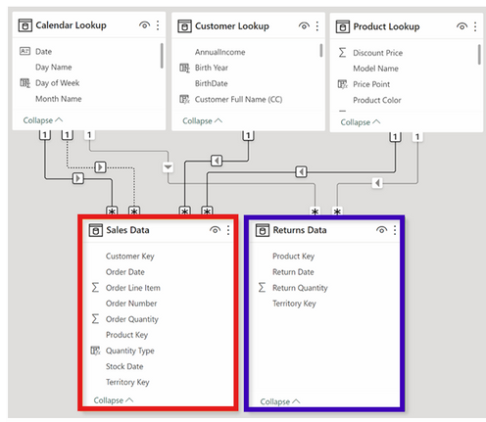

CONNECTING MULTIPLE FACT TABLES
This model contains two fact tables: Sales Data and Returns Data.
Since there is no primary
/foreign key relationship, we can’t connect them directly to each other.
Have you got it?
But we can connect each fact table to related lookups, which allows us to filter both sales and returns data using fields from any shared lookup
table
We can view orders and returns by product since both tables relate to Product Lookup, but we can’t view returns by customer since no relationship exists
Note : fact tables should connect through shared dimension tables, not directly to each other

Slide 4
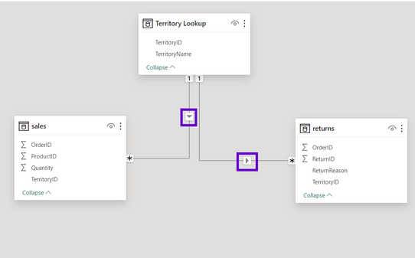

FILTER CONTEXT & FLOW
Here we have two data tables (Sales Data and Returns Data), connected to Territory Lookup
The arrows show the filter direction, and point from the one (1)
side of the relationship to the many (*) side
When you filter a table, that filter context is passed to any
related “downstream” tables, following the arrow’s direction
Filter context CANNOT flow “upstream”
Let’s see
with example
TIP: Arrange lookup tables above fact tables in your model as a visual reminder that filters always flow downstream

Slide 5
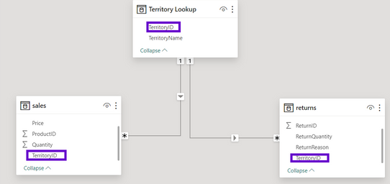

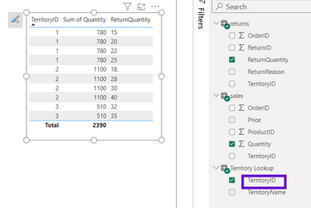
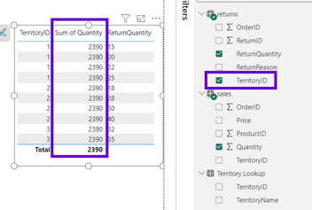
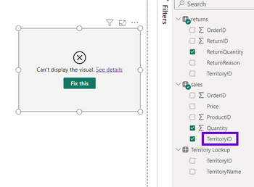
EXAMPLE: FILTER FLOW
In this model, the only way to filter both Sales and Returns data by
Territory is to use the Territory Key from the lookup table, which is
upstream and related to both fact tables
Look at once
Filtering using Territory Key from the Sales table yields incorrect Returns
values, since the filter context can’t flow to any other table
Filtering using Territory Key from the Returns table yields incorrect Sales values, and is limited to territories
that exist in the returns table
Filtering by Territory Lookup[Territory Key]. which is correct
Filtering by Returns Data[Territory Key].
Which is wrong
Filtering by Sales Data[Territory Key]. Which is also wrong

Slide 6


Thank you for joining me today to learn about Part -13 of Power BI!
Remember, mastering data modeling techniques is essential for unlocking the full potential of Power BI.
Stay tuned for more insights and tips on Power BI in our next Series.
Follow
Siddhika Shah

